Slide 1
Organs of the Immune System
Dr. Sandeep Kumar Sharma, BVSc & AH, MVSc and PhD
Assistant Professor, PGIVER
drsharmask01@hotmail.com
Mob. 9414775879

Slide 2
INTRODUCTION
The immune system is made up of organs that control the production and maturation of certain defense cells, the lymphocytes.
The organs and tissues of the immune system are divided into
1. Primary (Generative) lymphoid organs
2. Secondary (Peripheral) lymphoid organs.

Slide 3
In generative organs, the lymphocytes first express antigen receptors and attain phenotypic and functional maturity.
These organs are the maturation sites for immune cells in the absence of antigen.
In peripheral organs the responses to foreign antigens are initiated and developed.
These organs are the maturation sites for antigen driven immune cells.

Slide 4
The important generative organs for the mammals are the bone marrow where all types of lymphocytes originate and mature where T cells mature in thymus and reach a stage of functional competence.
In birds, apart from bone marrow they got another generative organ the Bursa of Fabricius-the site where B cells mature.
The important peripheral or secondary lymphoid organs are the lymph node, spleen, mucosa associated lymphoid tissues (MALT) and cutaneous immune system.

Slide 5
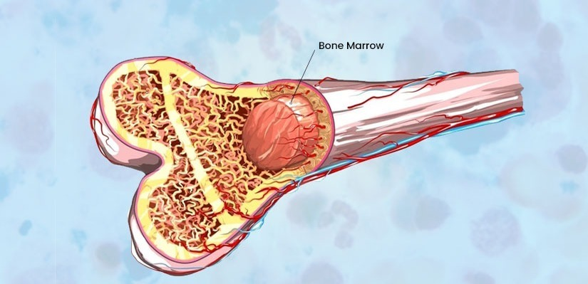
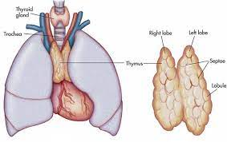
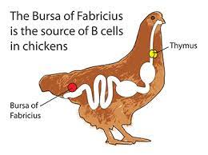
Primary lymphoid organ (Central)
Organs where immature lymphocytes develop
Bone marrow
Thymus
Bursa of fabricus

Slide 6
Secondary lymphoid organ (Peripheral)
Tissues where antigen is localized so that it can be effectively exposed to mature lymphocytes
Lymph nodes
Spleen
Tonsils
Appendix
Peyer's Patches (of GI tract)
Adenoids
MALT (Mucosal-Associated Lymphoid Tissue)
GALT (Gut-Associated Lymphoid Tissue)
BALT (Bronchial-Associated Lymphoid Tissue)
NALT (Nose-Associated Lymphoid Tissue)
VALT (Vulvovaginal-Associated Lymphoid Tissue)

Slide 7
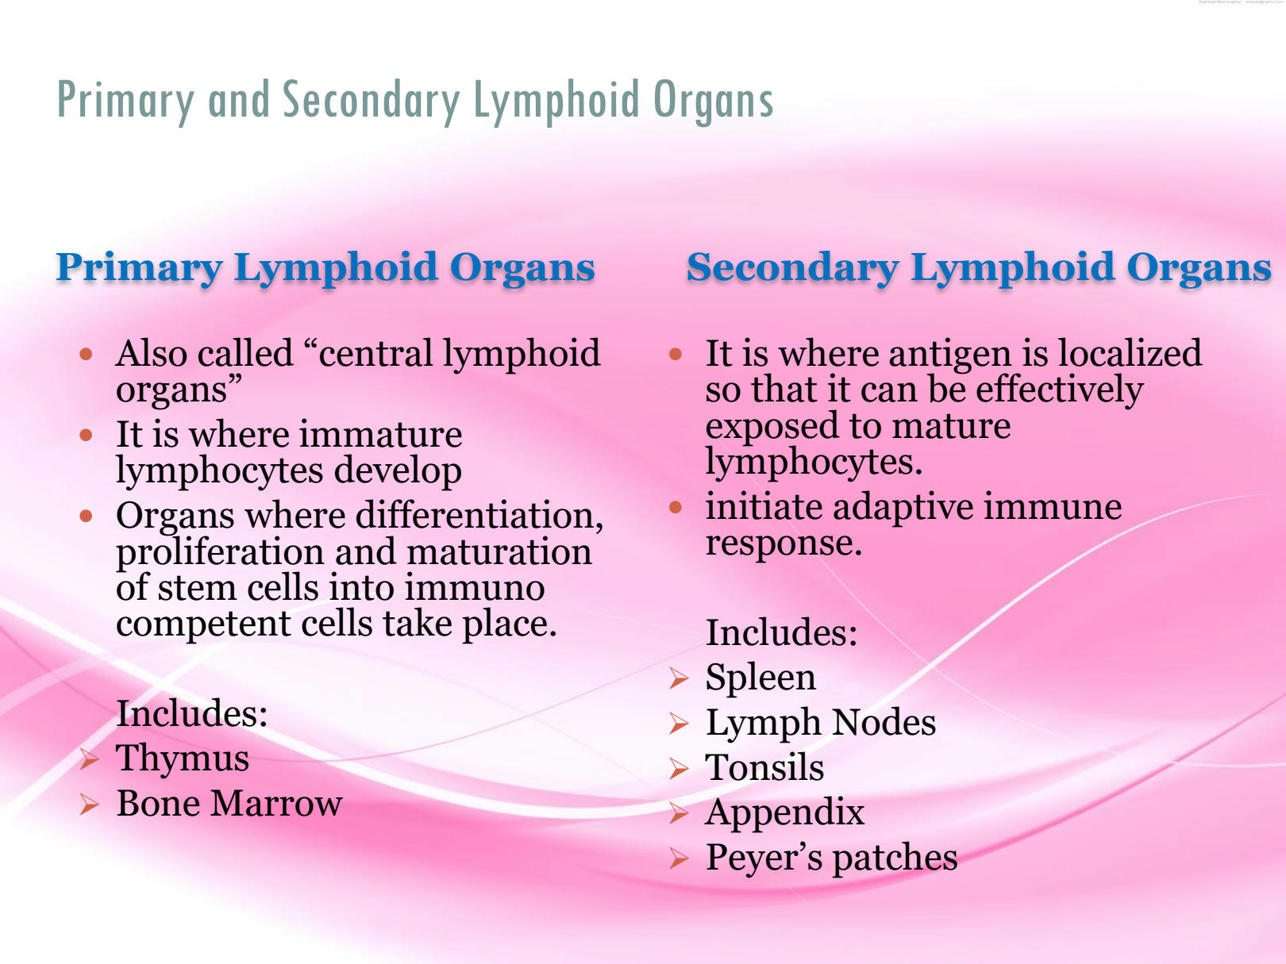

Slide 8
BONE MARROW
The first of the primary lymphoid organ is the bone marrow where all types of lymphocytes originate and mature.
The earliest forms of both T and B lymphocytes are recognized within the bone marrow, but in most species both immature cell types are exported from the marrow to undergo final maturation in further primary lymphoid tissues elsewhere in body.
In group II mammals such as rabbits and rodents B-cell development occurs within the bone marrow and in Appendix of rabbits.

Slide 9
Structure
Bone marrow is the soft, flexible connective tissue within bone cavities.
Bone marrow is separated into a vascular section and non-vascular sections.
There are two categories of bone marrow tissue: red marrow and yellow marrow.
From birth the majority of bone marrow is red marrow, after growth and maturation, increasing amounts of red marrow are replaced by yellow marrow.

Slide 10
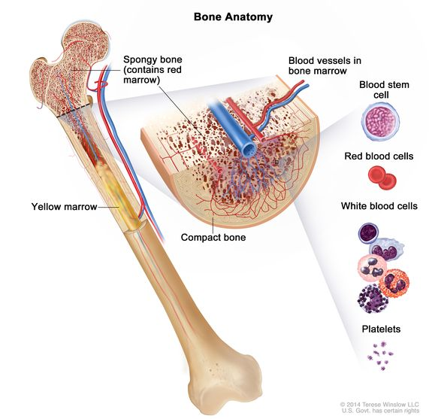
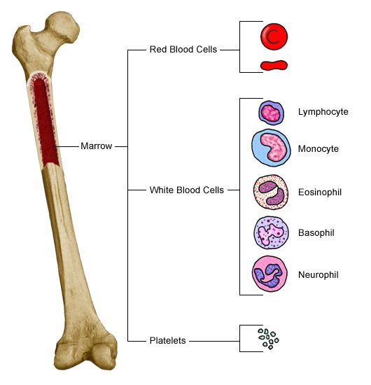

Slide 11
Functions- Red marrow contains hematopoietic stem cells that produce two other types of stem cells: myeloid stem cells and lymphoid stem cells.
These cells develop into red blood cells, white blood cells or platelets. Yellow marrow consists primarily of fat cells.
It is found in spongy bones and in the shaft of long bones.
Bone marrow is the site of B-cell origin and development.
Bone marrow secretes various cytokines that are required for development.

Slide 12
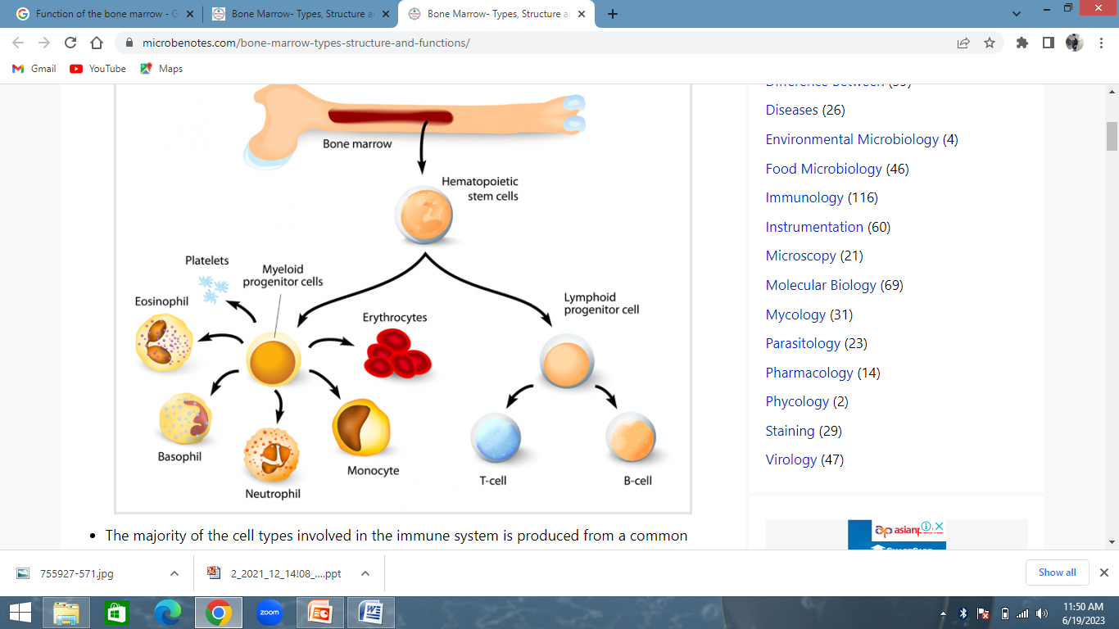

Slide 13
THYMUS
The thymus is located in the thoracic cavity in front of and below the heart.
In horses, cattle, sheep, pigs and chickens, it is also extends up the neck as far as the thyroid gland.
The size of thymus varies, its relative size being greatest in the newborn animal and its absolute size being greatest in puberty.
It may be very small and difficult to find in adult animals. The thymus is the site of T-cell development and maturation.

Slide 14
Structure
It is a flat, bilobed organ situated in front the heart.
Each lobe is surrounded by a capsule and is divided into lobules, which are separated from each other by strands of connective tissue called trabeculae.
Each lobule is organized into two compartments: the outer compartment, or cortex, is densely packed with immature T cells, called thymocytes, whereas the inner compartment, or medulla, is sparsely populated with thymocytes.

Slide 15
Structure
Within the medulla round, layered bodies found with containing concentric layers of degenerating epithelial cells called thymic or Hassall’s corpuscles.
These contain keratin, and the remains of a small blood vessel may be found at their center. In cattle these corpuscles may contain immunoglobulin A.
Some thymic epithelial cells in the outer cortex, called nurse cells, have long membrane extensions that surround as many as 50 thymocytes, forming large multicellular complexes.

Slide 16
Structure
An abnormally thick basemen membrane and a continuous layer of epithelial cells surround the capillaries that supply the thymic cortex.
This barrier prevents circulating antigens from entering the cortex. No lymphatic vessels leave the thymus.
As an animal ages the thymus shrinks and is gradually replaced by fat. However, the aged thymus still contains small amounts of lymphoid tissue and is functionally active.

Slide 17
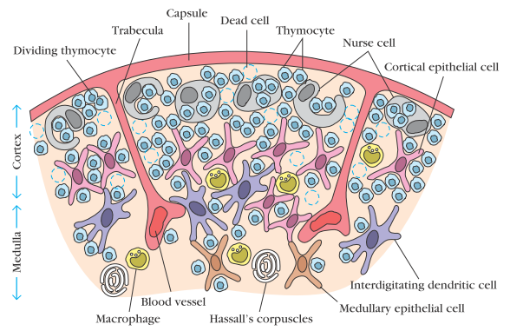
Structure

Slide 18
Function
Immature T lymphocytes are exported from the bone marrow to the thymus for their final maturation.
The functions of the thymus are best demonstrated by studying the effects of its surgical removal of this organ (thymectomy) in neonatal animal leads to an absence of T cells in adults and an inability to mount cell-mediated immunity (CMI), for which T cells are responsible.

Slide 19
BURSA OF FABRICUS
The Bursa of Fabricus is an organ found only in birds. It is a round sac located just above the cloaca.
Like the thymus, the bursa reaches its greatest size in the chick about 1 to 2 weeks after hatching and then shrinks at the bird ages.
It is very difficult to identify in older birds.

Slide 20
Structure
The bursa develops as a blind, sac-like and dorsal evagination of the cloaca wall.
Inside the sac folds of epithelium extend into the lumen, and scattered through the folds are round masses of lymphocytes called lymphoid follicles.
Each follicle is divided into a cortex and a medulla.
The cortex contains lymphocytes, plasma cells, and macrophages.

Slide 21
Structure
At the corticomedullary junction there is a basement membrane and capillary network on the inside of which are epithelial cells.
These medullary epithelial cells are replaced by lymphoblasts and lymphocytes in the center of the follicle.
It was noted that bursectomy (surgical removal of bursa) in chicks led to failure of B-cell development and an inability to produce antibody in adults.
These results indicate that the bursa is a primary lymphoid organ that functions as a maturation and differentiation of B cells in birds.

Slide 22
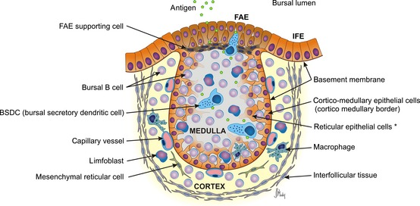
Mature bursal follicle – structure and antigen presentation. FAE – Follicle Associated Epithelium, IFE – Interfollicular Epithelium

Slide 23
Lymphatic System
As blood circulates under pressure, its fluid component (plasma) seeps through the thin wall of the capillaries into the surrounding tissue. Much of this fluid, called interstitial fluid, returns to the blood through the capillary membranes.
The remainder of the interstitial fluid, now called lymph, flows from the spaces in connective tissue into a network of tiny open lymphatic capillaries and then into a series of progressively larger collecting vessels called lymphatic vessels.

Slide 24
The largest lymphatic vessel, the thoracic duct, empties into the left subclavian vein near the heart.
In this way, the lymphatic system captures fluid lost from the blood and returns it to the blood, thus ensuring steady-state levels of fluid within the circulatory system. The heart does not pump the lymph through the lymphatic system.
A series of one-way valves along the lymphatic vessels ensures that lymph flows only in one direction.
When a foreign antigen gains entrance to the tissues, it is picked up by the lymphatic system (which drains all the tissues of the body) and is carried to various organized lymphoid tissues such as lymph nodes.

Slide 25
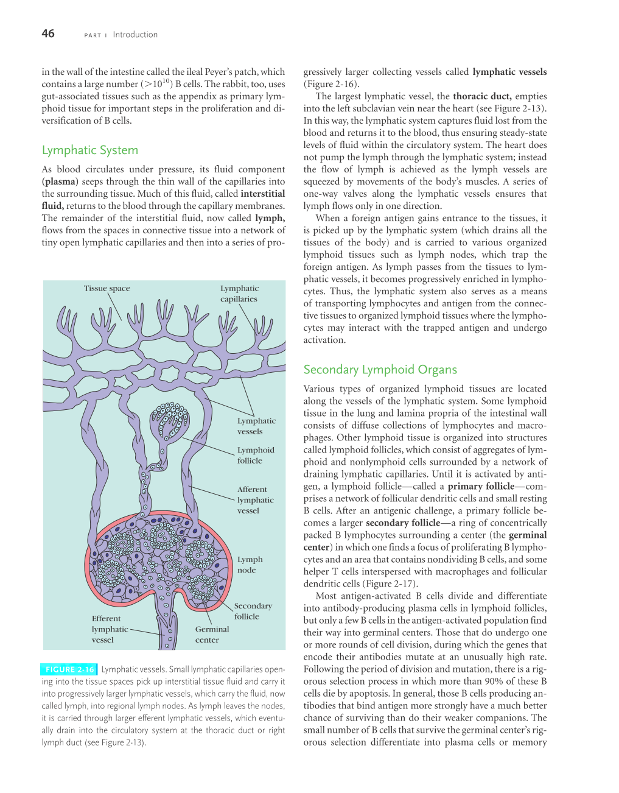
Small lymphatic capillaries opening into the tissue spaces pick up interstitial tissue fluid and carry it into progressively larger lymphatic vessels, which carry the fluid, now
called lymph, into regional lymph nodes.

Slide 26
SECONDARY LYMPHOID ORGANS
LYMPH NODES
Extracellular fluid flows from capillary beds into tissue; from this tissue it enters lymphatic capillaries that are "pumped" along with the movement of skeletal muscle towards lymph nodes.
The paracortical areas of the nodes contain T cells, and the central areas contain germinal centers, where B cells are contained.

Slide 27
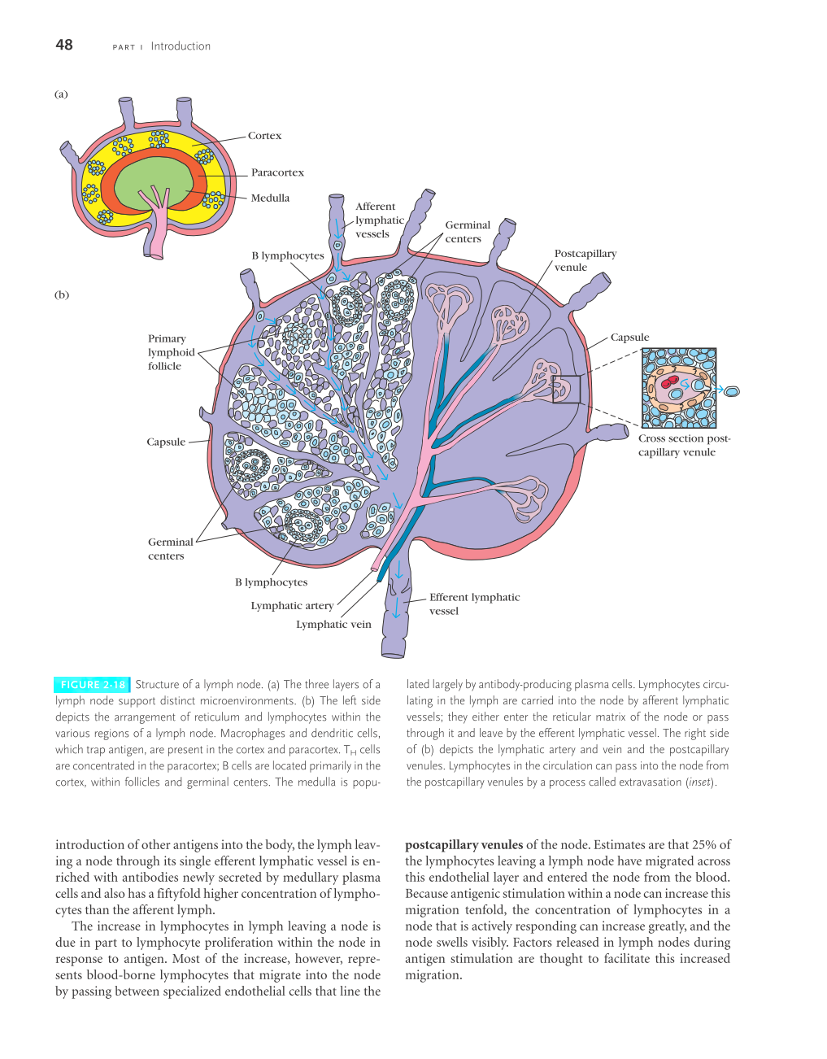
LYMPH NODES
Lymph nodes are the sites where immune responses are mounted to antigens in lymph.
They are encapsulated bean- shaped structures containing a reticular network packed with lymphocytes, macrophages, and dendritic cells.
Clustered at junctions of the lymphatic vessels, lymph nodes are the first organized lymphoid structure to encounter antigens that enter the tissue spaces.
Morphologically, a lymph node can be divided into three roughly concentric regions:
Cortex
Paracortex,
Medulla

Slide 28
The outermost layer, the cortex, contains lymphocytes (mostly B cells), macrophages, and follicular dendritic cells arranged in primary follicles.
After antigenic challenge, the primary follicles enlarge into secondary follicles, each containing a germinal center.
In children with B-cell deficiencies, the cortex lacks primary follicles and germinal centers.
Beneath the cortex is the paracortex, which is populated largely by T lymphocytes and also contains interdigitating dendritic cells thought to have migrated from tissues to the node.

Slide 29
These interdigitating dendritic cells express high levels of class II MHC molecules, which are necessary for presenting antigen to T_{H} cells.
The paracortex is therefore sometimes referred to as a thymus-dependent area in contrast to the cortex, which is a thymus-independent area.
The innermost layer of a lymph node, the medulla, is more sparsely populated with lymphoid-lineage cells; of those present, many are plasma cells actively secreting antibody molecules.

Slide 31
As antigen is carried into a regional node by the lymph, it is trapped, processed, and presented together with class II MHC molecules by interdigitating dendritic cells in the paracortex, resulting in the activation of T_{H} cells.
The initial activation of B cells is also thought to take place within the T-cell-rich paracortex.
Once activated, T_{H} and B cells form small foci consisting largely of proliferating B cells at the edges of the paracortex.
Some B cells within the foci differentiate into plasma cells secreting IgM and IgG.

Slide 32
SPLEEN
It is a large, ovoid secondary lymphoid organ situated high in the left abdominal cavity that plays a major role in mounting immune responses to antigen in the bloodstream.
While lymph nodes are specialized for trapping antigen from local tissues.
The spleen specializes in filtering blood and trapping blood-borne antigens; thus, it is particularly important in the response to systemic infections.
Instead, blood-borne antigens and lymphocytes are carried into the spleen through the splenic artery and out via the splenic vein.

Slide 33
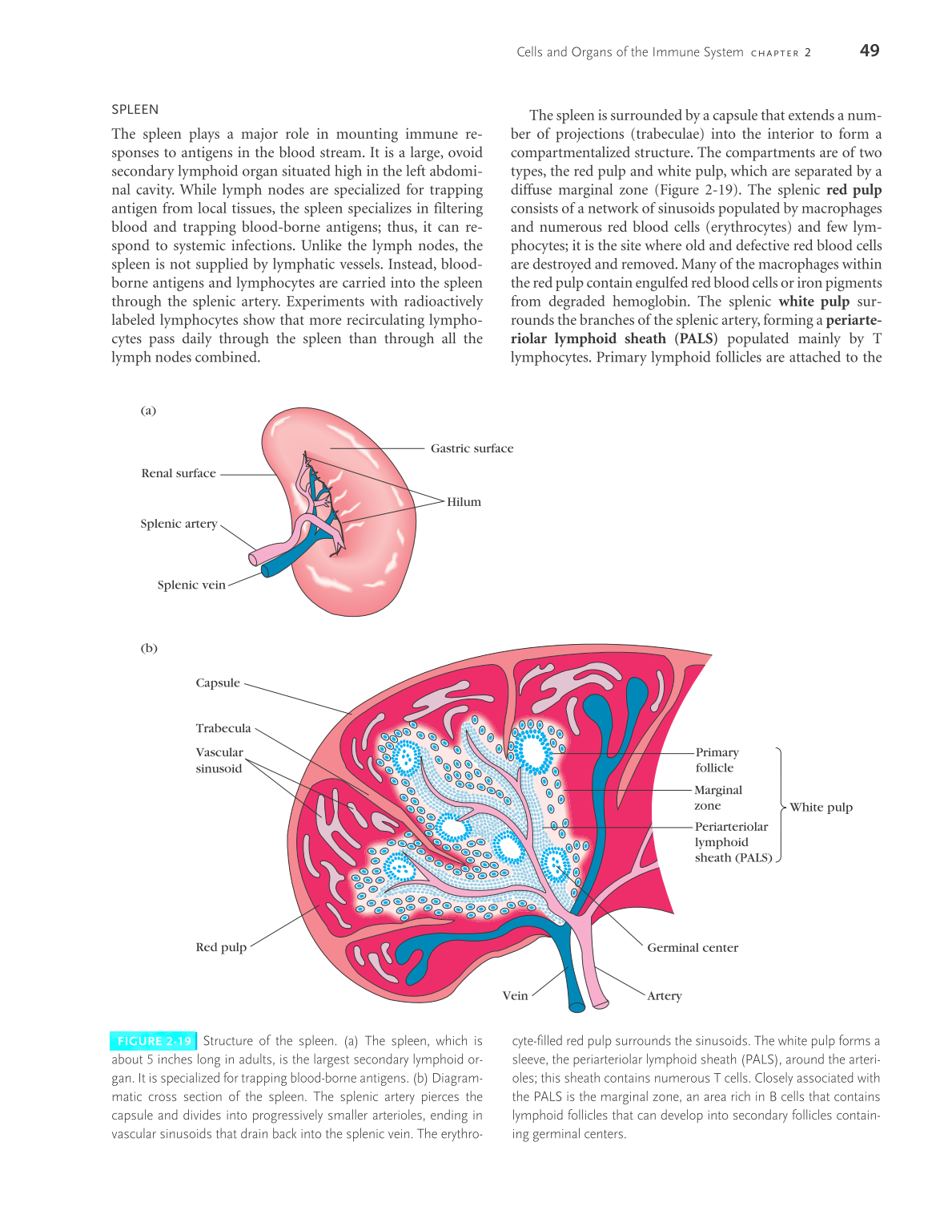
SPLEEN
Unlike the lymph nodes, the spleen is not supplied by lymphatic vessels.
Experiments with radioactively labelled lymphocytes show that more recirculating lymphocytes pass daily through the spleen than through all the lymph nodes combined.

Slide 34
Structure of Spleen
The spleen is surrounded by a capsule from which a number of projections (trabeculae) extend, to form a compartmentalized structure and providing structural support.
Two main compartments can be distinguished in splenic tissue: the red pulp and white pulp, which are separated by a specialized region called the marginal zone.
The splenic red pulp consists of a network of sinusoids populated by red blood cells, macrophages, and some lymphocytes.
It is the site where old and defective red blood cells are destroyed and removed.

Slide 35
Structure of Spleen
The splenic white pulp surrounds the branches of the splenic artery, forming a periarteriolar lymphoid sheath (PALS) populated mainly by T lymphocytes.
Primary lymphoid follicles are attached to the PALS. These follicles are rich in B cells and some of them contain germinal centers.
The marginal zone, located peripheral to the PALS, is populated by lymphocytes and macrophages.

Slide 36
The splenic artery pierces the capsule and divides into progressively smaller arterioles, ending in vascular sinusoids that drain back into the splenic vein. The erythrocyte-filled red pulp surrounds the sinusoids. The white pulp forms a sleeve, the periarteriolar lymphoid sheath (PALS), around the arterioles; this sheath contains numerous T cells. Closely associated with the PALS is the marginal zone, an area rich in B cells that contains lymphoid follicles that can develop into secondary follicles containing germinal centers.

Slide 37
Function of Spleen
Blood-borne antigens and lymphocytes enter the spleen through the splenic artery, which empties into the marginal zone.
In the marginal zone, antigen is trapped by interdigitating dendritic cells, which carry it to the PALS.
Lymphocytes in the blood also enter sinuses in the marginal zone and migrate to the PALS.
The initial activation of B and T cells takes place in the T-cell-rich PALS. Here interdigitating dendritic cells capture antigen and present it combined with class II MHC molecules to T_{H} cells. Once activated, these T _{H} cells can then activate B cells.

Slide 38
MALT (Mucosa associated lymphoid tissues)
Lymph nodes and the spleen are not the only organs that develop secondary lymphoid microenvironments.
T and B-cell zones and lymphoid follicles are also found in mucosal membranes that line the digestive, respiratory, and urogenital systems, as well as in the skin.

Slide 39
MALT (Mucosa associated lymphoid tissues)
Mucosal membranes have a combined surface area of about 400 m² (nearly the size of a basketball court) and are the major sites of entry for most pathogens.
These vulnerable membrane surfaces are defended by a group of organized lymphoid tissues known collectively as mucosa-associated lymphoid tissue (MALT).

Slide 40
Lymphoid tissue associated with different mucosal areas is sometimes given more specific names; for instance, the respiratory epithelium is referred to as bronchus-associated lymphoid tissue (BALT) or nasal-associated lymphoid tissue (NALT), and that associated with the intestinal epithelium is referred to as gut-associated lymphoid tissue (GALT).

Slide 41
The structure of GALT is well described and ranges from loose, barely organized clusters of lymphoid cells in the lamina propria of intestinal villi to well-organized structures such as the tonsils and adenoids (Waldeyer’s tonsil ring), the appendix, and Peyer’s patches, which are found within the intestinal lining and contain well-defined follicles and T-cell zones.
The outer mucosal epithelial layer contains intraepithelial lymphocytes (IELs), many of which are T cells.

Slide 42
The lamina propria, which lies under the epithelial layer, contains large numbers of B cells, plasma cells, activated T cells, and macrophages in loose clusters.
Peyer’s patches, nodules of 30 to 40 lymphoid follicles, extend into the muscle layers that are just below the lamina propria.
The overall functional importance of MALT in the body’s defense is underscored by its large population of antibody-producing plasma cells, whose number exceeds that of plasma cells in the spleen, lymph nodes, and bone marrow combined.

Slide 43
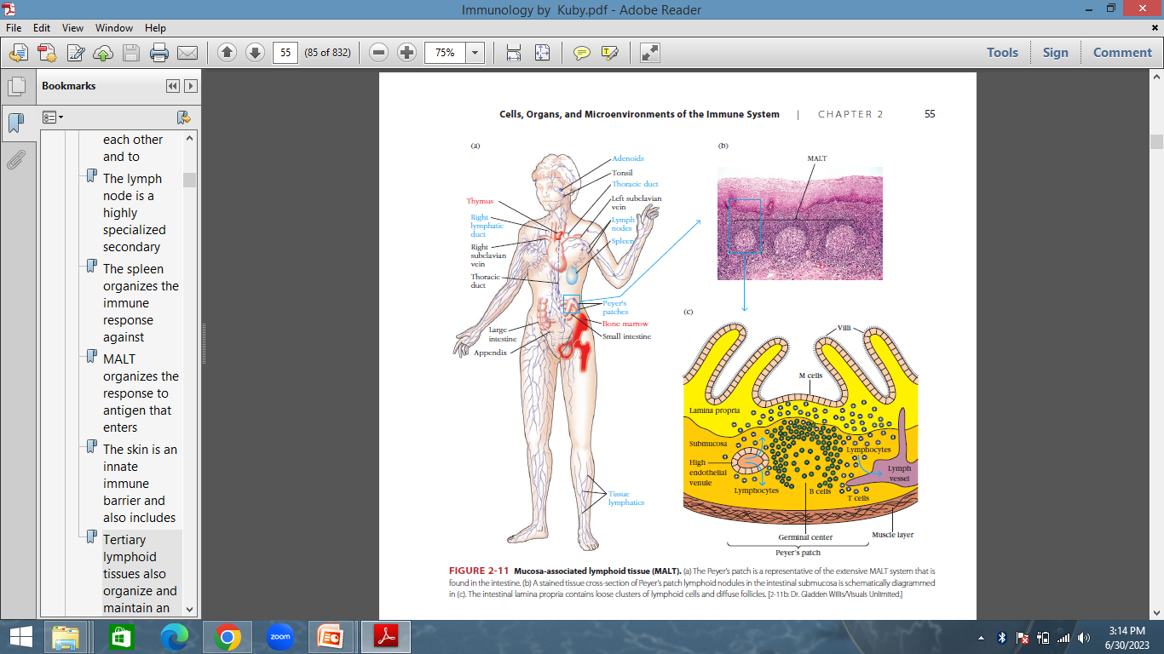
A stained tissue cross-section of Peyer’s patch lymphoid nodules in the intestinal submucosa and The intestinal lamina propria contains loose clusters of lymphoid cells and diffuse follicles

Slide 44
Some cellular structures and activities are unique to MALT.
For instance, the epithelial cells of mucous membranes play an important role in delivering small samples of foreign antigen from the respiratory, digestive, and urogenital tracts to the underlying mucosa-associated lymphoid tissue.

Slide 45
In the digestive tract, specialized M cells transport antigen across the epithelium.
The structure of M cells is striking: they are flattened epithelial cells lacking the microvilli that characterize the rest of the mucosal epithelium.
They have a deep invagination, or pocket, in the basolateral plasma membrane, which is filled with a cluster of B cells, T cells, and macrophages.

Slide 46
Function of M cell
Antigens in the intestinal lumen are endocytosed into vesicles that are transported from the luminal membrane to the underlying pocket membrane.
The vesicles then fuse with the pocket membrane, delivering antigens to clusters of lymphocytes and antigen-presenting cells, the most important of which are dendritic cells, contained within the pocket.
Antigen transported across the mucous membrane by M cells ultimately leads to the activation of B cells that differentiate and then secrete IgA.

Slide 47
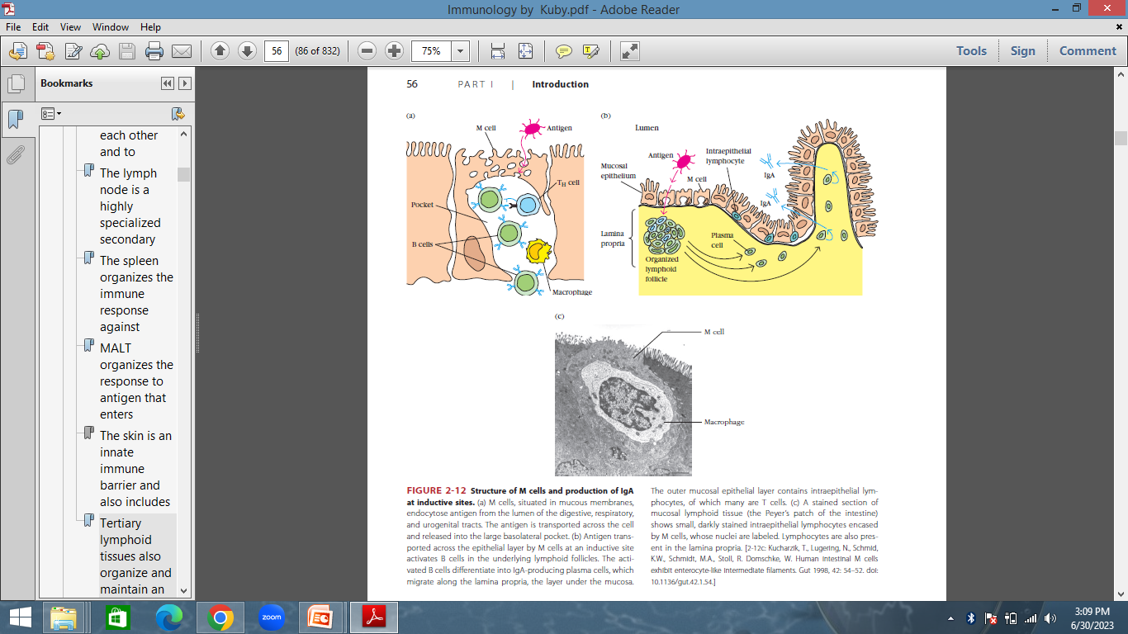
Structure of M cells and production of IgA at inductive sites.

Slide 48
Cutaneous-Associated Lymphoid Tissue: Skin
The skin is the largest organ in the body and a critical anatomic barrier against pathogens. It also plays an important role in nonspecific (innate) defenses.
The epidermal (outer) layer of the skin is composed largely of specialized epithelial cells called keratinocytes. These cells secrete a number of cytokines that may function to induce a local inflammatory reaction.
The underlying dermal layer of the skin also contains scattered lymphocytes, dendritic cells, monocytes, macrophages, and may even include hematopoietic stem cells.

Slide 49
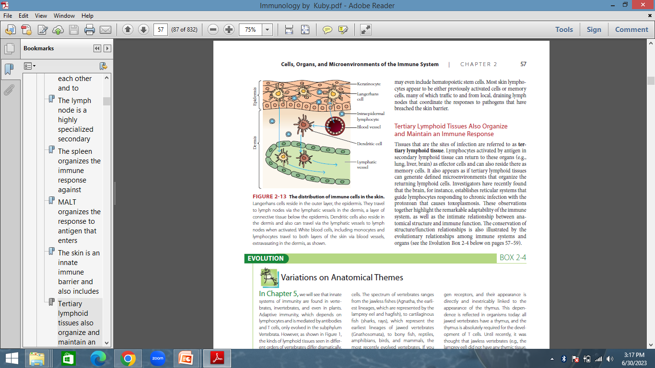
The distribution of immune cells in the skin

Slide 50
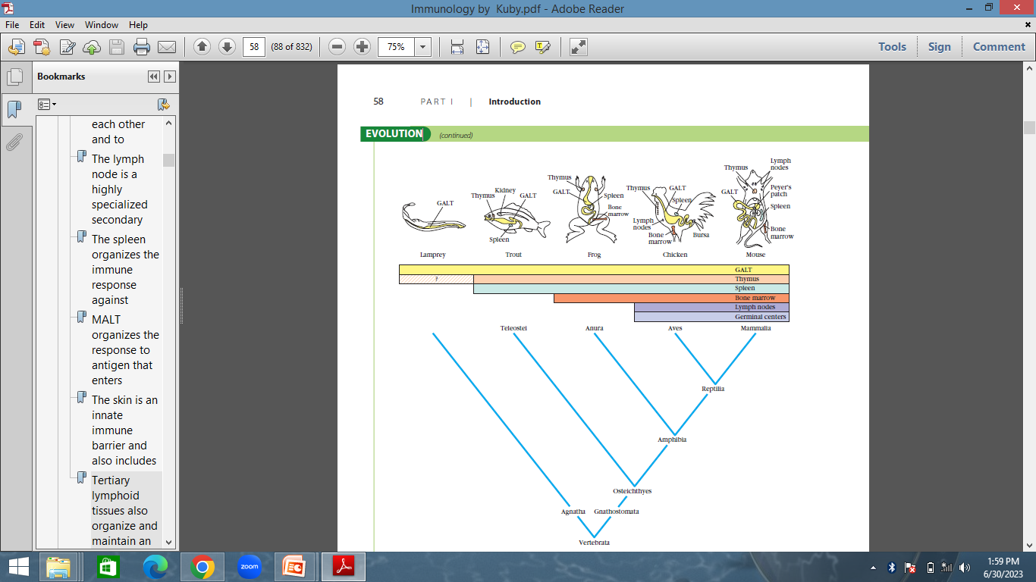
Evolutionary distribution of lymphoid tissues
The presence and location of lymphoid tissues in several major orders of vertebrates

Slide 51
Thank You
Dr. Sandeep Kumar Sharma, BVSc & AH, MVSc and PhD
Assistant Professor, PGIVER
drsharmask01@hotmail.com
Mob. 9414775879

